Slide 1
    Detect Alert Extinguish
    The New Way To Control Unwanted Fires
Mark Baldino
mark@firebotsuppression.com
703-906-3154
Pat Riordan
pat@firebotsuppression.com
443-623-6160
Firebot A Device that will Eliminate Half Of All Home Fires

Slide 2
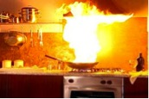
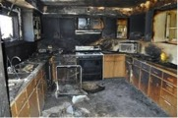
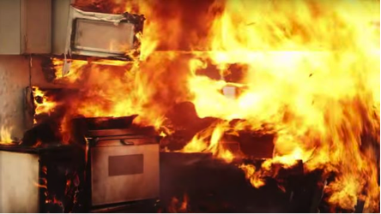
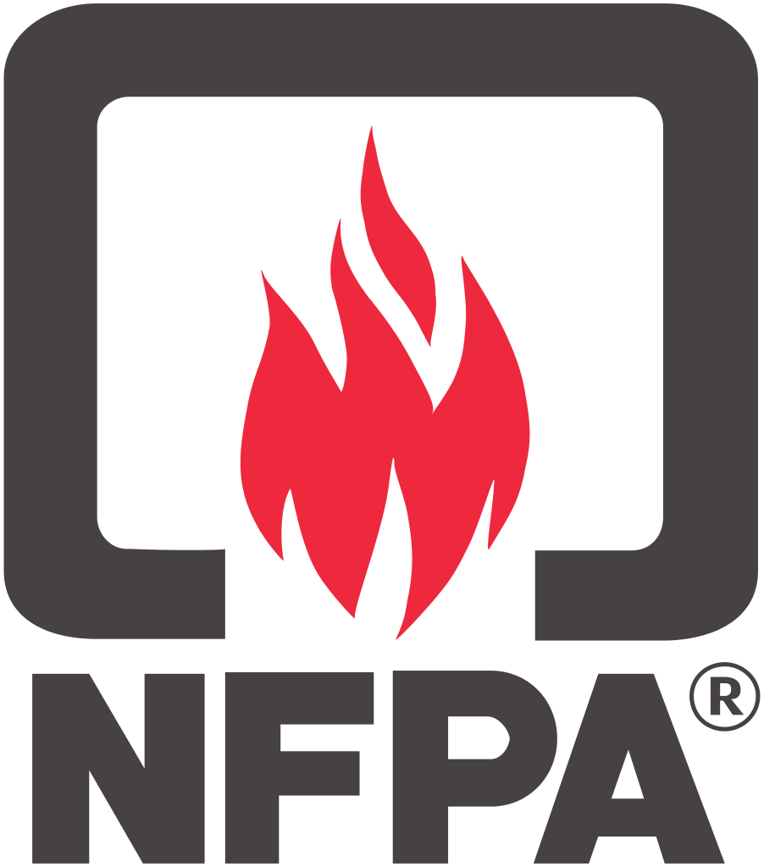
The Problem
In the US alone over half of all home fires start on kitchen stovetops. Smoke, flame and water damage all take their toll every year.
166,100 fires per year require an official fire department response.
480 deaths and 5,540 injuries.
1.1 billion dollars in damage.
The U.S. Consumer Product Safety Commission reports 4.7 million stovetop fires per year do not require a response from the fire department. Translating to roughly one of every 23 occupied households per year had a cooking fire.
Fires that cause heartache and displacement for the families in single homes and multi-family units
Data Provided by The National Fire Protection Association

Slide 3
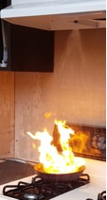
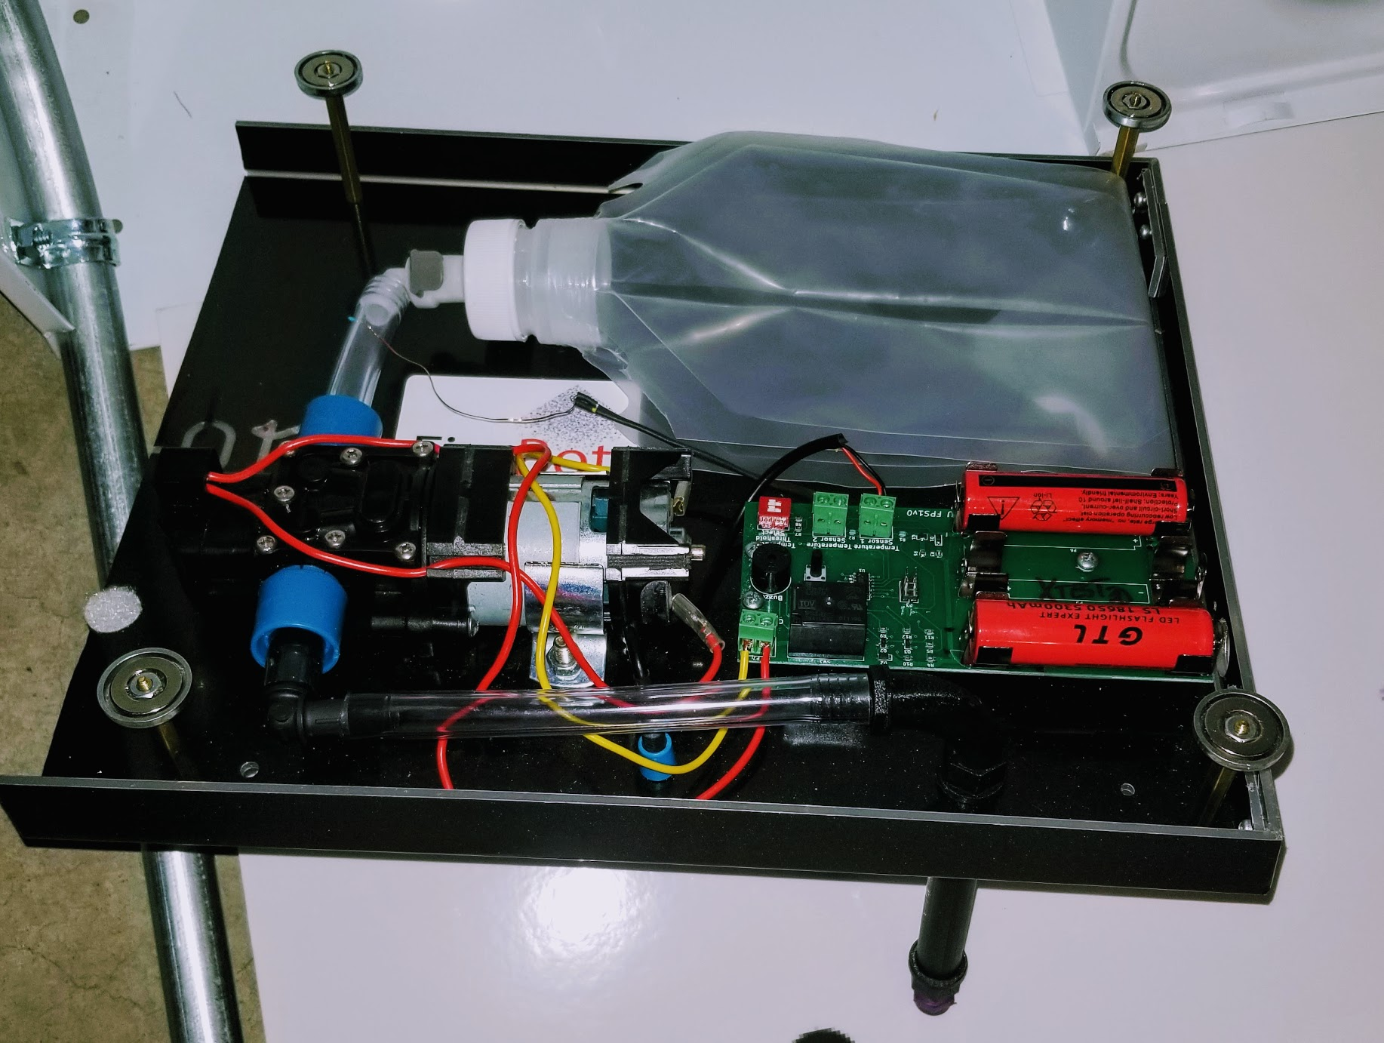
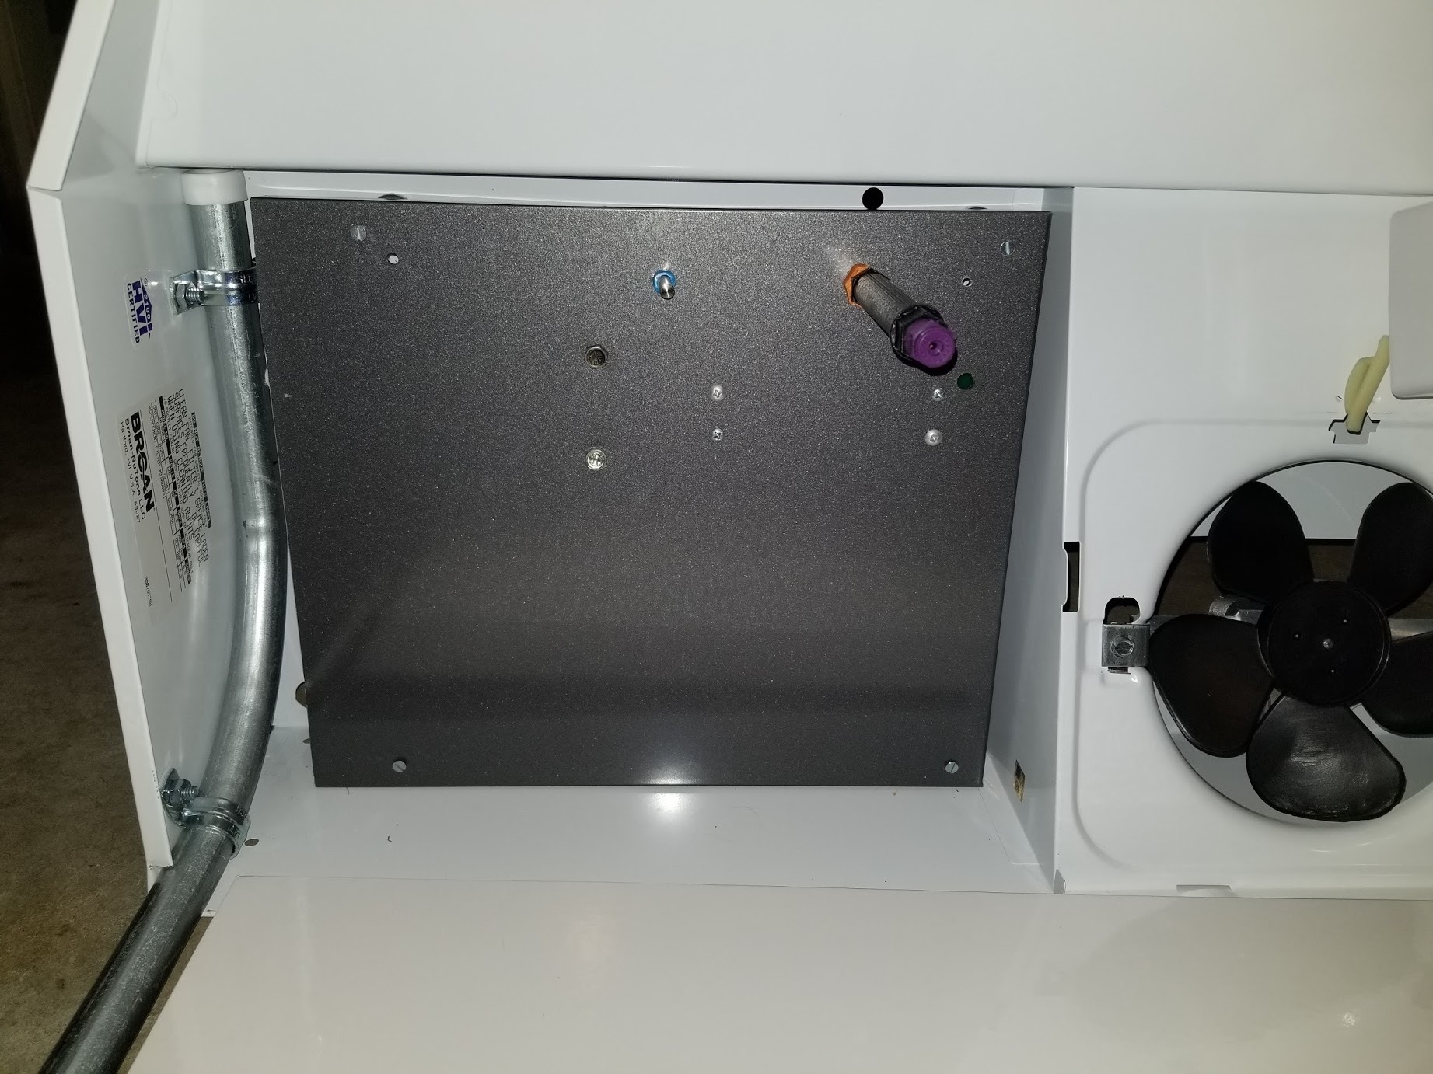
The Solution-FireBot
Firebot can safely extinguish 50% of all home fires by targeting them at their source before they cause damage.
A huge edge to the firefighters who have less chance of getting hurt.
The insurance companies and building owners who will save money.
Most important, the lives saved and injury prevented. An amazing new product in the world of fire protection. Firebot a good product for all.

Slide 4
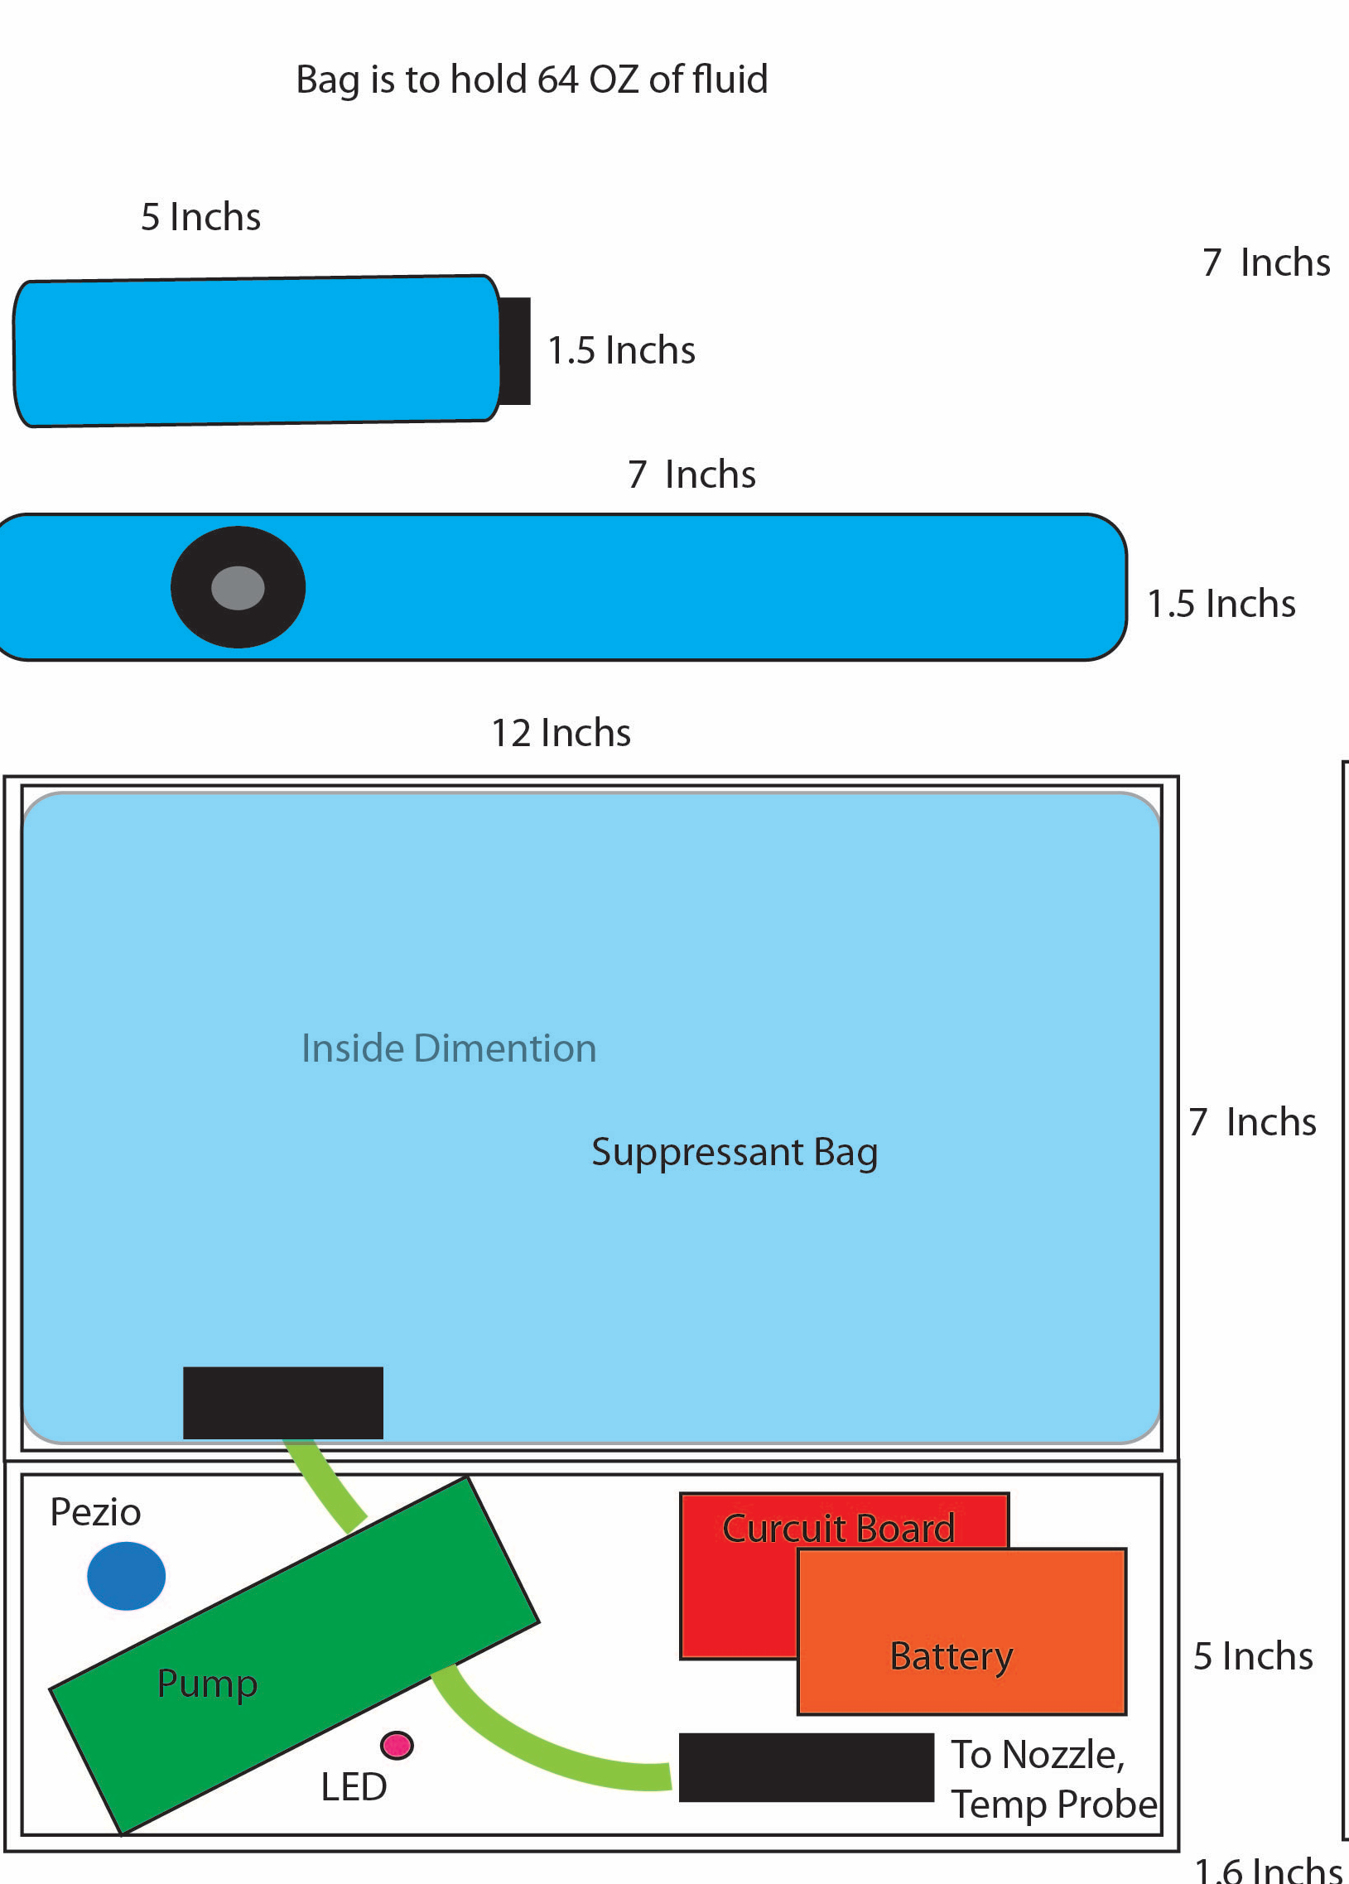
How?
FireBot is a low-cost device that will automatically activate to properly extinguish a stovetop fire.
A patent pending battery operated device with a 3-year life that can both warn and extinguish a fire automatically.
Mounted above kitchen stovetops, out of sight, in the range hood. It waits till it reads an abnormal high temperature that signals an out of control stovetop fire.
Upon FireBot Activation:
It sprays fire suppressant (not water) to extinguish, even a grease fire, on all four burners.
Activates an audible warning alarm.
Future models will have Z-wave signal to turn off the electric or gas flow to the burners.
Future versions will have wireless capabilities to notify the owner or monitoring station of activation or low battery condition.
FireBot the new way to control unwanted fires.
Notes:
See Italics

Slide 5
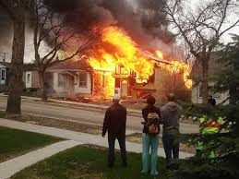
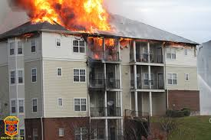
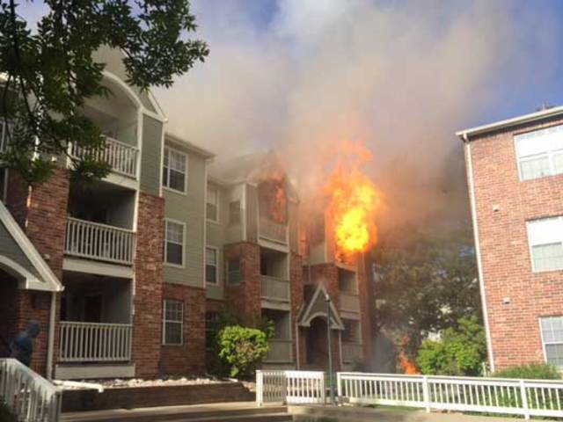
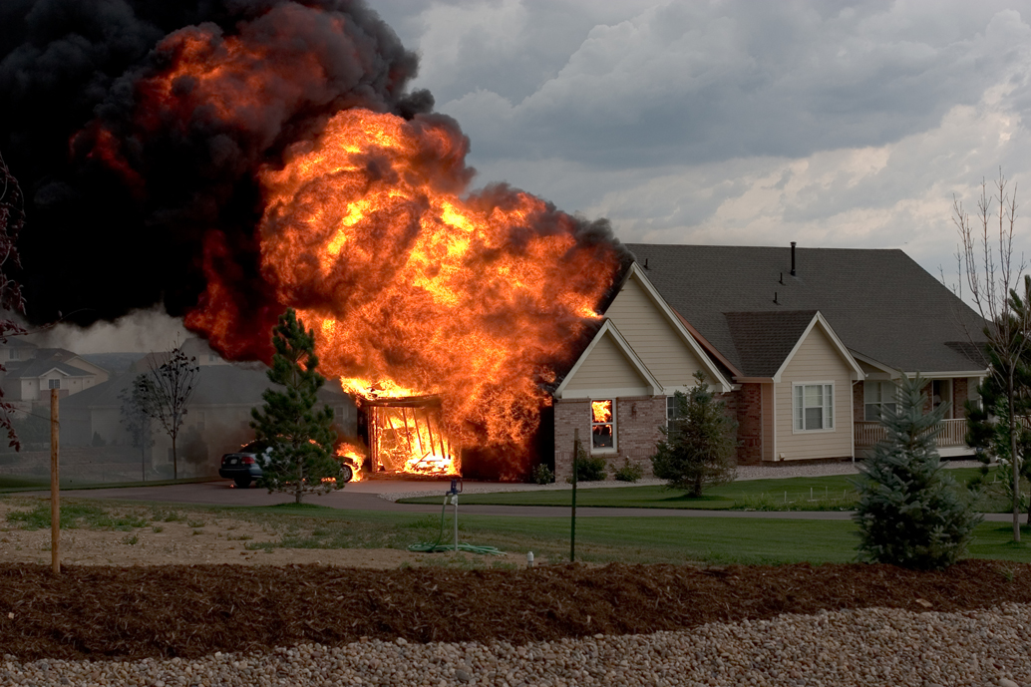
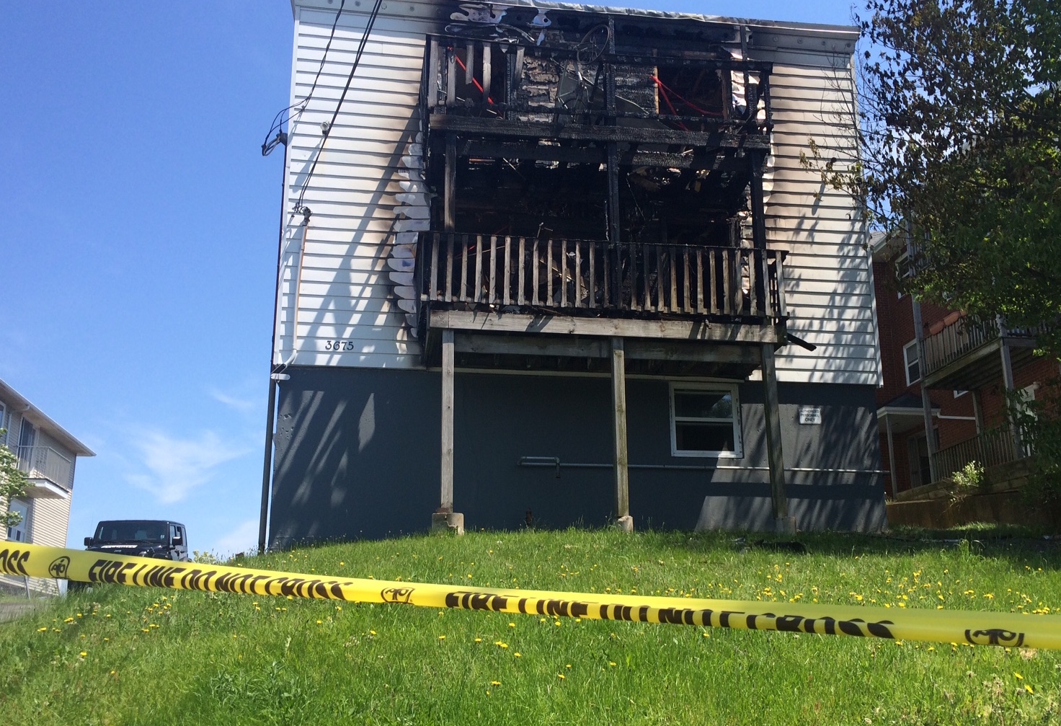
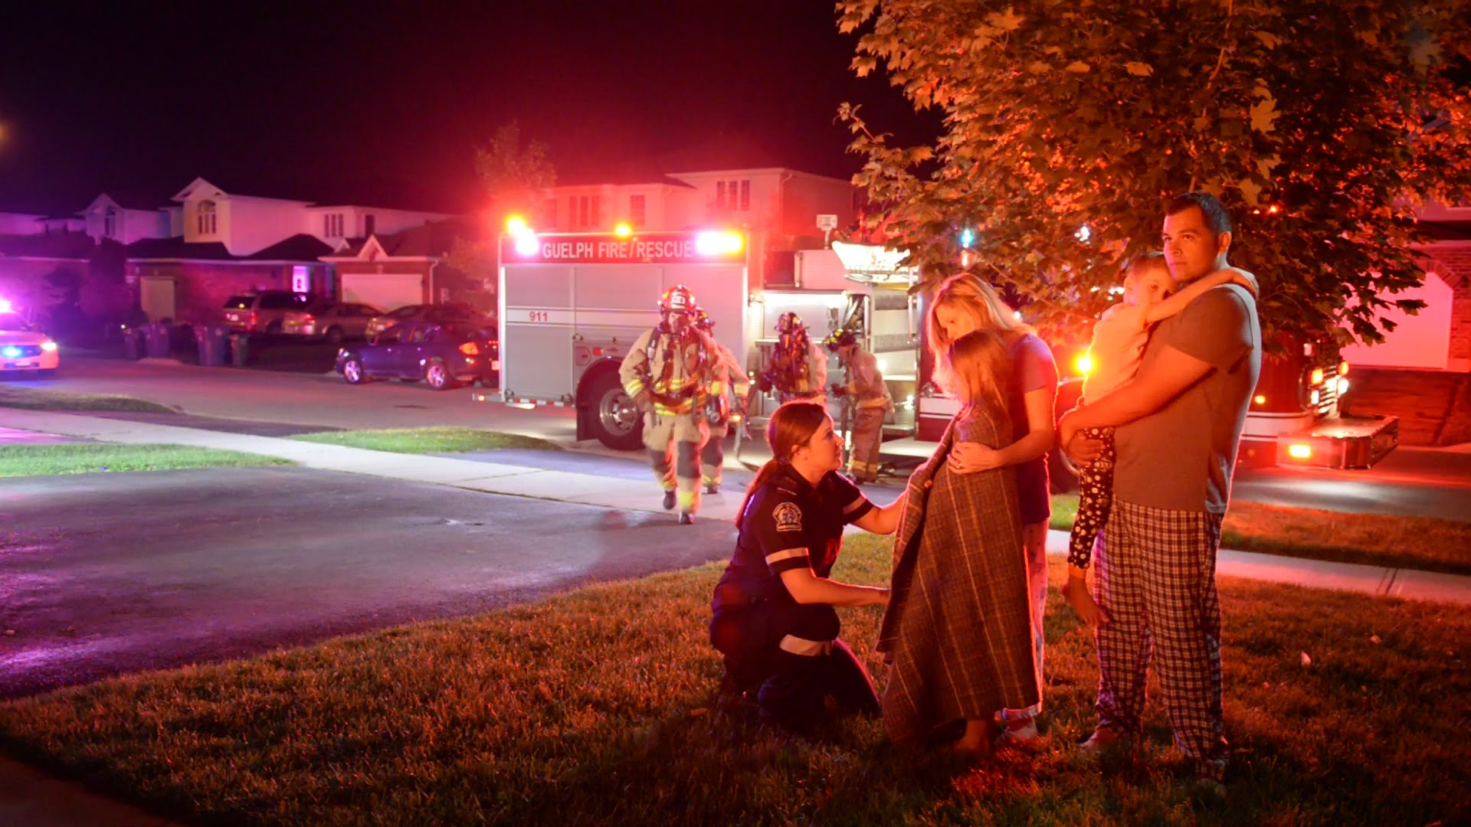
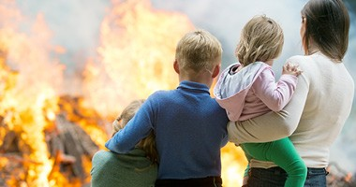
Apartment and Condominium Management Companies
First on the list will be Apartment and Condo management companies who control 30 million units.
One fire may affect many units, displacing an untold number of tenants.
The need for a product like FireBot is overwhelming. Want and need become the same for the owners and their tenants, to make their buildings a safe place to live.
FireBot Installation could stop half of all multi-family fires wherever installed.
For any safety budget, FireBot would naturally be on the top of the list. The cost of one fire prevented would save them many times the cost of FireBot installation.
FireBot once meeting UL300A standards, Insurance companies would consider premium discounts to encourage installation, lowering or totally negating installation costs.
FireBot for Apartments and Condos, a smart move for all involved.

Slide 6
Fire Marshals, Firefighters, Local and State Government
With a UL300A label FireBot will be recommended for safety reasons. A future goal, governments will write Firebot into their building codes in order to stop stovetop fires. This simple code addition will cut residential fires in half where FireBot is installed. FireBot included in building codes would make FireBot a must for new construction.
An Added Bonus
FireBot installed in all kitchens would cut residential fire department responses in half. Good for both City and County budgets and Fire Departments. Less responses mean less chance of firefighter injuries and savings on dispatches. FireBot installation would be a big plus for it’s citizens as it protects and saves money for all.

Slide 7
Builders and Fire Restoration Companies
Companies for new construction, remodeling and fire restoration of kitchens would have a new device in FireBot to add to every kitchen.
This would protect homes from stovetop fires, effectively reducing the risk of smoke, flame and water damage in the future.
Once FireBot is required by building code, installation will be automatic and so will sales.
Fire occurs on kitchen stovetops over 166,000 times per year. Fire Restoration and Builders companies repair these damages.
If even 10% of homeowners want the protection of FireBot that would result in sales of 16,000 units per year.
It would be a great time to finish off the kitchen rebuild with a FireBot to insure a stovetop fire would not happen again.

Slide 8
Home Stores and Online Sales
Mass market consumer sales in big box stores. Together Home Depot and Lowes have over 4,000 locations. Anyone in the country can purchase FireBot.
FireBot is easily installed, magnets attached in seconds to any range hood.
Perfect for the do-it yourself market.
If each store sold one FireBot per month that would generate 48,000 units sold per year or $5,760,000 in gross profit.
We believe that number would be higher, as 35 million smoke alarms are sold each year comparable as a similar fire safety device.

Slide 9
Insurance Companies Will Help facilitate Sales
Insurance companies if they know FireBot can save lives, injury, and property damage and it’s use will save them money by preventing fire damage will facilitate sales.
With FireBot meeting UL 300A requirements, they will be glad to recommend and give premium discounts in order to encourage installation.
The insurance discounts that may follow will lower installation costs to the Apt and Condo management companies and homeowners alike making FireBot very affordable and cost effective. It is also possible in the future insurance coverage may be denied if Firebot is not installed in the kitchen as standard safety equipment.

Slide 10

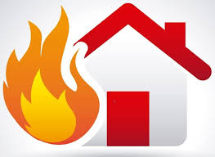

Alarm Companies Will Help With Additional Sales
FireBot’s Z-Wave communications is easily programmed into existing alarm control panels. FireBot an extra device to sell and installed is a great device for added revenue to be included with every system sold. Good for the 13 billion dollar alarm industry.
Let’s be conservative 1 sold each month by 5000 salespeople equals 60,000 per year or a 7 million in gross profit a year just for FireBot.

Slide 11
Range Hood Manufacturers
Upon acceptance, Manufacturers will incorporate FireBot in their housings for their new range hood models.
This will include range hoods for both electric and gas stovetops
Microwaves which double as range hoods can easily have FireBot built into the vent system. Both to prevent stovetop fires and add additional revenue per unit sold.
FireBot versions will also be designed to work with wall and counter exhaust fans to cover any configuration possible, which one may encounter for stovetops.

Slide 12
Boats, RV, Mobile Homes, Military Housing, Federal Gov’t, Aviation
Fires can break out anywhere, marine fires can be extra terrifying, RV’s have the same concerns many times without constant power, so our battery operated FireBot is perfect.
Military operations in the field need spot fire protection. Base housing is sometimes primitive and dated. Firebot would add a layer of security they currently do not have.

Slide 13
Home Automation Integration
FireBot is a home automation compatible device. As home automation becomes commonplace in homes so will FireBot.
FireBot
Home alarm Panels
Stove Power Shunt Switches
Electric - Gas
Cell phone alerts
Central Station Monitoring
Low battery, activation alarm, 5 year maintenance alerts

Slide 14
Marketing Plan
Our Marketing Plan will include a multi-prong approach.
A simple but effective plan covering all major sales influencers and market areas.
Five quadrants or divisions, with sub sectors
Apt & Condo Sales
Fire Marshalls & Government
Insurance Companies
Recreational Vehicles
Consumer Retail
Notes:
Five quadrants or divisions, with sub sectors
Emphasis will be on Apt and Condo Sales one sale may place thousands of unit for an entire complex or management company.
Fire Fighters, Fire Marshals, Local, State, and Federal Governments
Insurance companies and their agents
Consumer Retail through the big box stores and internet sales
Recreational vehicles and Marine applications

Slide 15
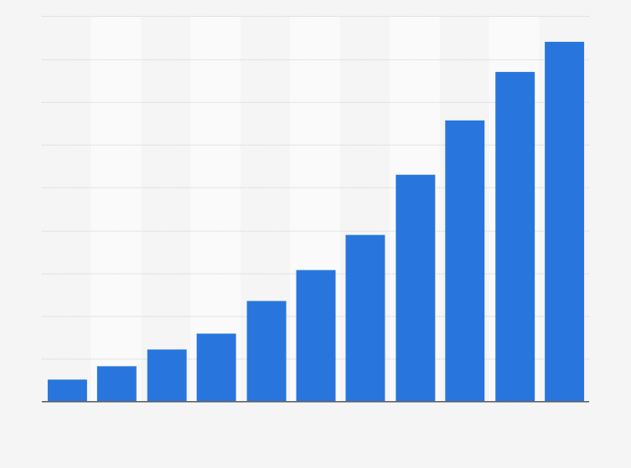
Reachable Sales Goals A Must
A realistic sales goal is one that we can expect once Firebot is ready for market.
Our goal sell 10,000 units first year.
How? Start with 5000 Apt, Condo management companies. Our sales department will call, e-mail, visit, demo, and send information to each to tell them about the FireBot advantage.
If 500 or 10% would buy 20 FireBots we have sold 10,000 units. Or if one buys 10,000 units. That is equals $1.65 million in sales or 1.2 million in gross profit. Not a Bad Start! We are at this point economically self sufficient. All the investors have an excellent chance to get their investment back with the first divided with more to come by owning equity in the company.

Slide 16
Future Sales A Huge Market. A Huge Demand
We won’t stop with just 10,000 units. Our potential market is 100 million kitchens just in the U.S alone, 30 million in multifamily apartments and condos.
Sell 200,000 FireBots, that’s 24 million in gross profit.
Sell 833,000 Firebots, that’s 100 million in gross profit. Valuation of the company, one that would make your minor investment very valuable.

Slide 17
Some Logical thoughts in today’s illogical world
Residential fires caused by stovetop fires cause 1.1 billion dollars of damage a year, 480 deaths, 5,000 injuries. Countless displacements of families while repairs are being made. Deductibles and temporary housing cost millions of dollars more.
We already spend money to prevent and contain fires, using sprinkler systems, commercial range hood systems, smoke detectors, state of the art fire departments and all sorts of UL fire ratings for locks, doors and construction. Why not just stop the fire before it starts? Install FireBot and you have an instant device to not only warn but extinguish a fire.
We have all kinds of wonderful car safety devices, costing thousands per car and we of course are glad to pay. Why not add a $165 device to your stovetop so the country can save billions of dollars in damage, eliminate deaths, and injury due to stovetop fires.
Another benefit, FireBot installed in all kitchens would cut residential fire department responses in half. City, County and City budgets would love FireBot savings on less dispatches.

Slide 18
Better than a chance To Be Successful
There is not a product as strong as FireBot. Effective in it’s purpose to stop fires.
FireBot is low cost affordable device to add to a stovetop, installs in a seconds to any range hood. It’s purpose to detect, warn and extinguish a fire.
Saves lives, injury and billions of dollars in damage and claims.
FireBot will have the advantage of a push/pull effect created by many entities recommending, and others purchasing to protect their property and occupants, further insuring sales.
We have 100,000,000 kitchens in the U.S. alone. If we place Firebot in just one percent, that would equal One Million units sold. This translates to 1.2 billion dollars in potential sales in just the U.S. alone. FireBot will work. It’s a good investment. Better than a chance.

